Slide 1


Slide 2
What Do we need to build a machine learning model?

Slide 3
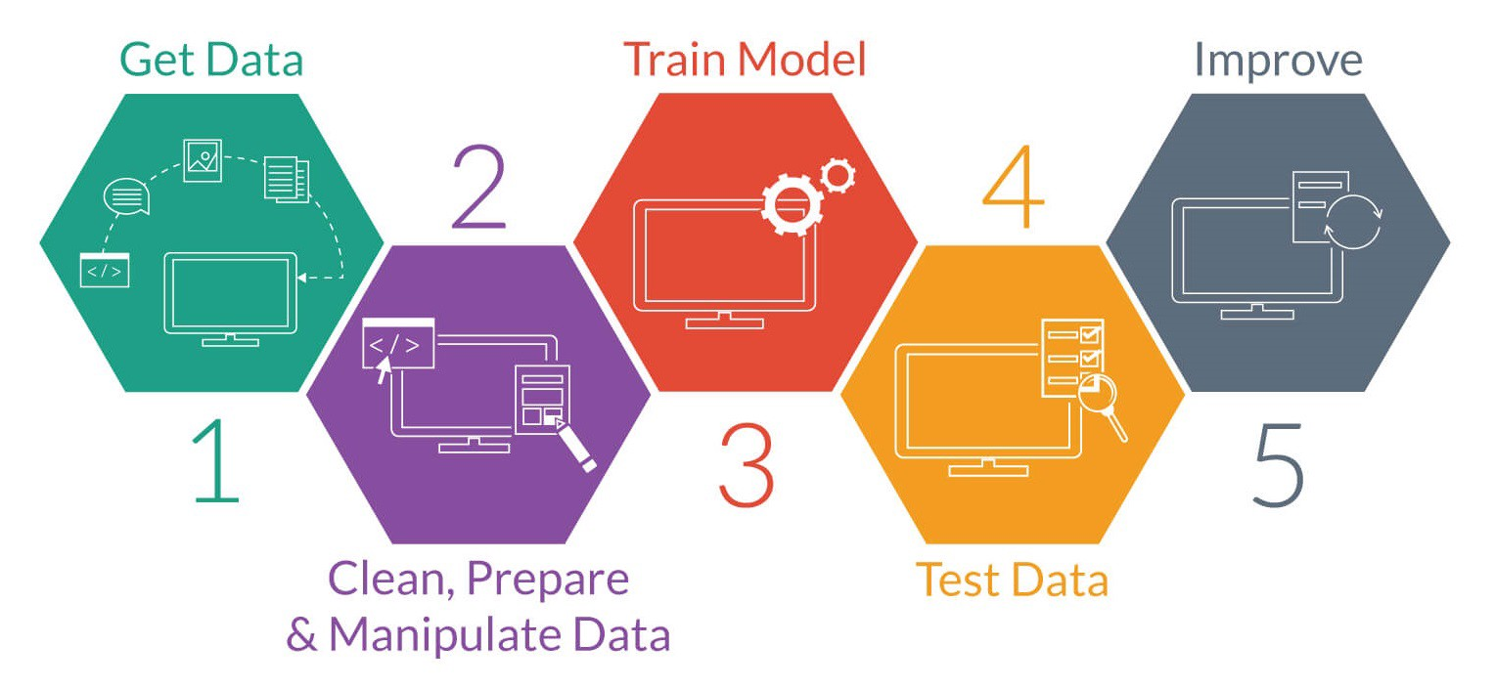
Building a Machine Learning model

Slide 4
Data Collection
For an innovative project:
you need to be innovative ☺ --
Collect data yourself, simulations, use existing data in a different way, .. find a way
In many cases, you may deal with legacy systems and extract data from them

Slide 5
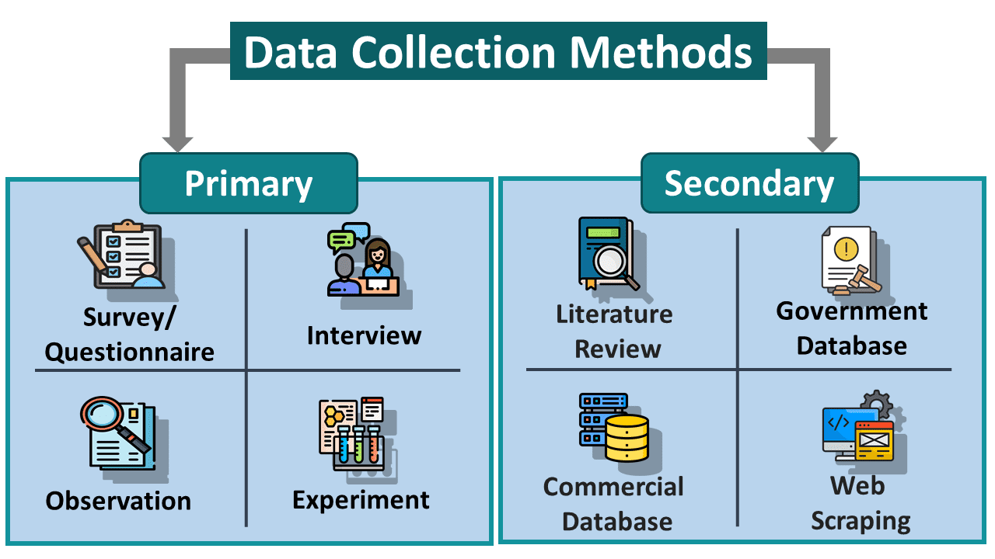

Slide 6

Data needs to be in the form of:
Features
Numerical (Quantitative)
Categorical (Qualitative)
Ordinal : categories has relative order like grades (A , B+ , C, etc.)
Nominal : categories has no relative order like gender (Male, Female)
Labels
Continues : in regression
Discrete : in classification

Slide 7

Now I have the data, can I build the model?
Not yet, you must prepare the data

Slide 8
Combine data from various sources
Check data schema:
Usually, the source of the data has schema describing the data
Clean your Data: identify and handle errors in your data.
Handle Missing data
Handle outliers
Data Transformation: change the scale of some/all variables. Why?? We will discuss it later.
Feature Selection: select these features that are most relevant to your task.
Feature Engineering: combine features, derive new variables, dimensionality reduction, etc.
Data Preparation

Slide 9
Exploratory Data Analysis
We can’t prepare the data without first exploring the data.
Quantify missing data
Identify numerical and categorical variables
Determine unique values (cardinality) in categorical features
Check rare/ dominant categories in categorical features
Highlight outliers
Identify linear relationships
Identify a normal distribution
Check histograms

Slide 10
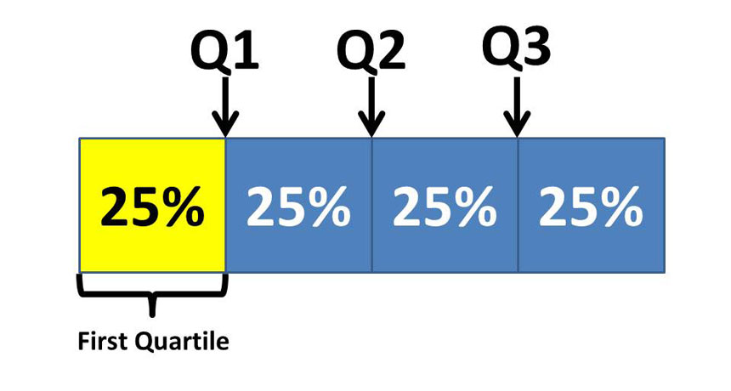
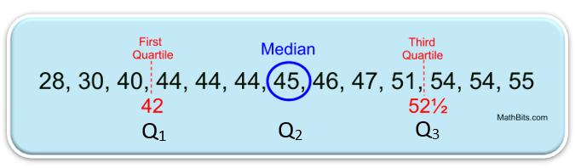

Slide 11
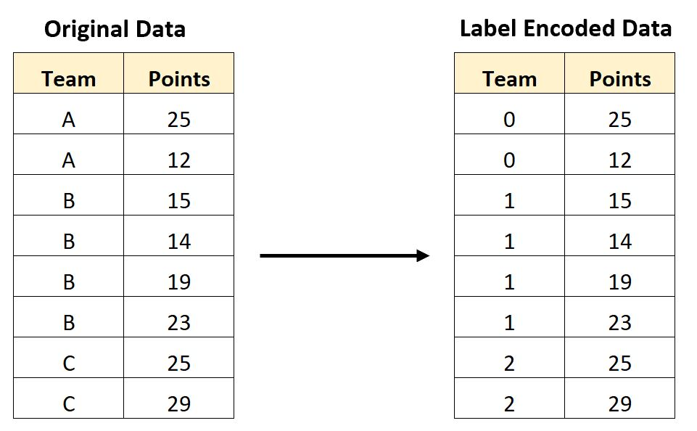

Slide 12
